Slide 1
Other Concurrent Collections: BlockingQueues

Slide 2
The concurrency problem
Why do we need BlockingQueue?
Producers create data
Consumers process data
Shared queue must be thread-safe
Need automatic waiting when:
queue is full
queue is empty
Ex :
Producer thread → queue → consumer thread
queue full = producer waits
queue empty = consumer waits

Slide 3
What is a BlockingQueue?
Thread-safe queue for inter-thread communication
Part of java.util.concurrent
Supports blocking operations
methods:
put(e) → waits if full
take() → waits if empty
offer(e) → returns immediately / optional timeout
poll() → returns immediately / optional timeout
BlockingQueue combines storage + synchronization.

Slide 4
Why BlockingQueue is powerful ?
no manual wait() / notify()
clean producer-consumer design
built-in thread safety
easier and safer than custom synchronization
Manual synchronization = complex
BlockingQueue = simple and safe

Slide 5
Types of BlockingQueue
BlockingQueue
ArrayBlockingQueue
LinkedBlockingQueue
PriorityBlockingQueue
DelayQueue
SynchronousQueue
Optional
BlockingDeque
LinkedBlockingDeque
TransferQueue
LinkedTransferQueue

Slide 6
BlockingQueue
BlockingQueue is a thread-safe queue designed for producer-consumer scenarios. The major benefit is that it handles waiting automatically. If the queue is full, producers wait. If it is empty, consumers wait.
ArrayBlockingQueue
ArrayBlockingQueue uses a fixed-size array internally and behaves like a circular buffer. It is bounded, so it gives us backpressure naturally.
LinkedBlockingQueue
LinkedBlockingQueue uses linked nodes and generally allows better producer-consumer concurrency because put and take operations are more independent.

Slide 7
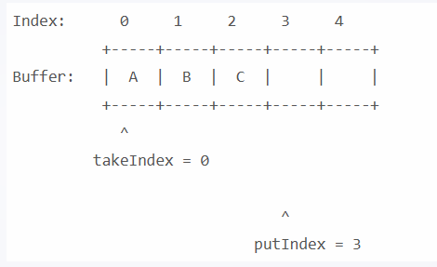
ArrayBlockingQueue
Content:
Bounded queue
Backed by fixed-size array
FIFO order
Single lock for put/take operations
Internal characteristics:
fixed capacity
blocks producers when full
blocks consumers when empty
Ex: Array slots: [A][B][C][ ][ ]
How ArrayBlockingQueue works internally
Content:
circular array
indices:
put index
take index
one lock controls access
uses conditions for:
notFull
notEmpty
Visual: Circular buffer diagram:
putIndex
takeIndex
You can say:
It behaves like a ring buffer.

Slide 8
Best use cases for ArrayBlockingQueue
Content:
bounded producer-consumer systems
memory-sensitive systems
predictable capacity needed
when fixed-size buffering is required
Trade-off:
lower memory overhead
but one lock may limit throughput under high contention

Slide 9
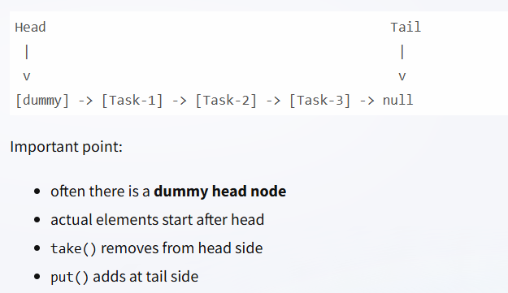
LinkedBlockingQueue
Content:
Typically linked-node based queue
Can be bounded or effectively unbounded
FIFO order
Separate locks for put and take
Key point:
Better concurrency between producers and consumers than ArrayBlockingQueue.
How LinkedBlockingQueue works internally
Content:
linked nodes
head and tail references
separate locks:
putLock
takeLock
capacity can be specified
Visual: Head -> Node1 -> Node2 -> Node3 -> Tail
Explain:
producer and consumer can progress more independently

Slide 10
ArrayBlockingQueue vs LinkedBlockingQueue
ABQ vs LBQ
Feature | ArrayBlockingQueue | LinkedBlockingQueue
Data structure | Array | Linked nodes
Capacity | Fixed | Optional bound
Locking | Single lock | Separate put/take locks
Memory usage | Lower | Higher
Throughput | Good | Often better under mixed load

